Slide 1

















Disability Inclusion: Assistive Device Support by the
Bangladesh Red Crescent Society (BDRCS)
Detail Technical Assessment
Sourcing of the assistive devices
  In partnership with Centre for Disability in Development (CDD)
  Identify the persons with disabilities in need of assistive devices to enhance mobility, communication,and daily living functions.
Final Handover
  Procurement and delivery of the assistive devices to BDRCS branches
  Final handover of the devices.
  Connect them with local BDRCS branch and public health official.
Step 01
Step 02
Step 03
Step 04
Step 05
Step 06
Households Assessment
Prepare Final List + Specs of Devices
Technical Orientation
  Done in emergency phase to identify the needs. Includes “Washington Group Short Set of Questions” to identify the basic info.
  Families with persons with disability received additional cash grant.
Prepare the final list along with required device details and initiate procurement.
  CDD provide details technical orientation on how to uses the devices.

Slide 2
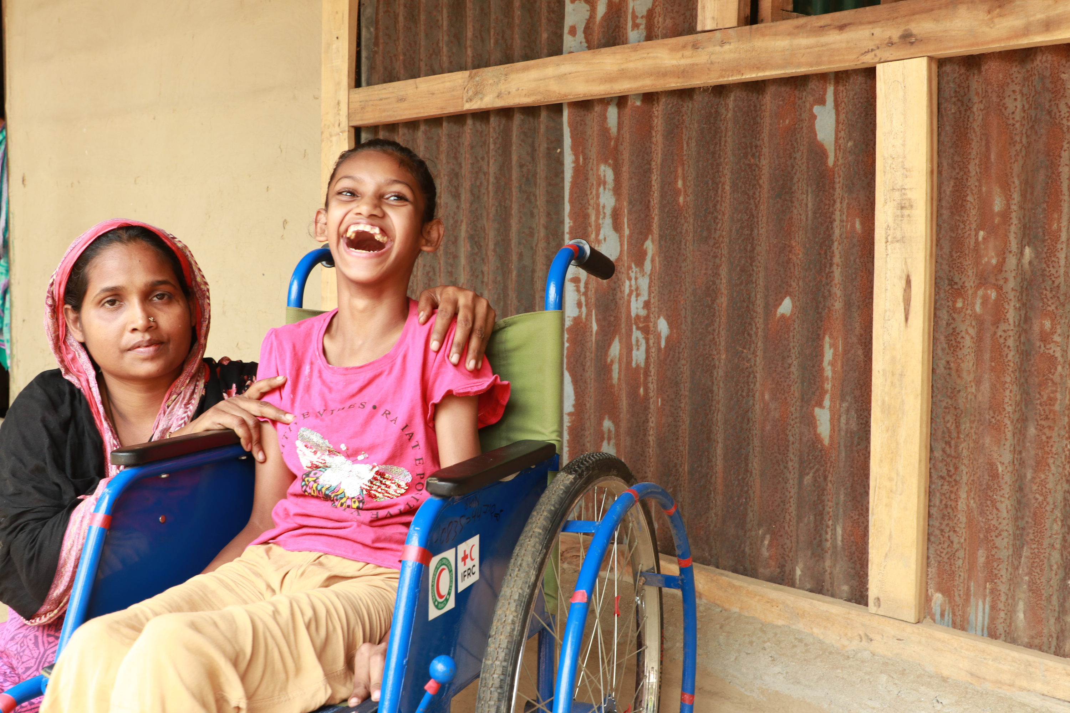
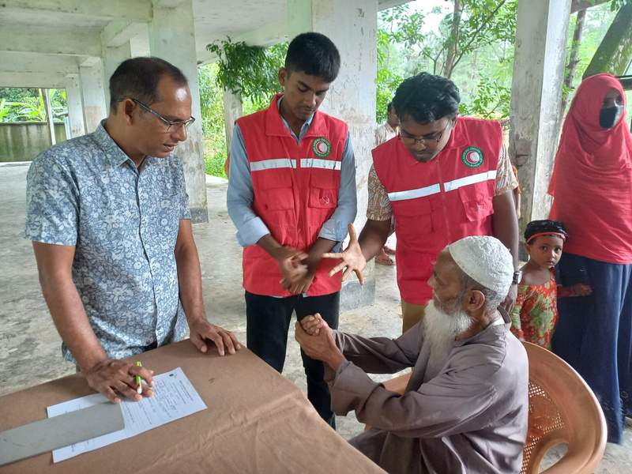
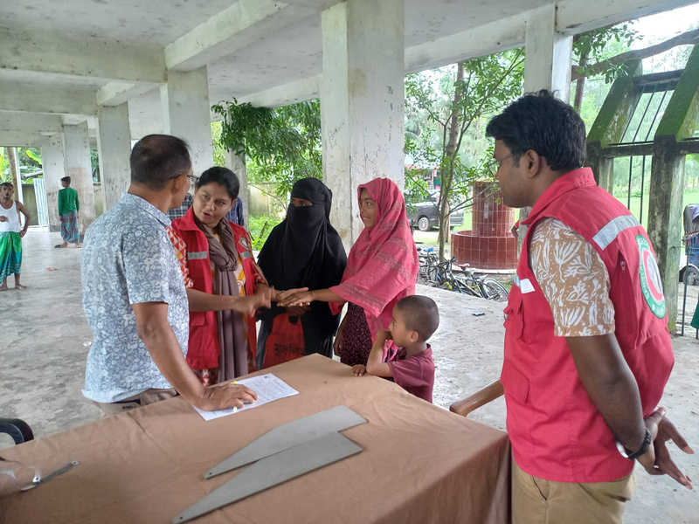
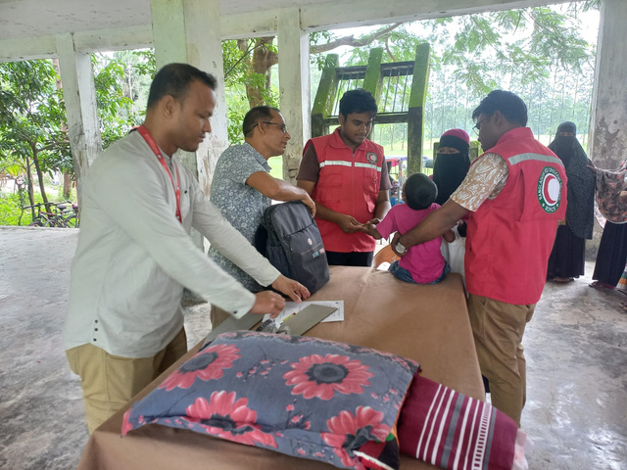
Challenges
  Limited accessibility in temporary shelters and homes.
  Lack of awareness on the use of assistive devices - risk of secondary health complications due to prolonged immobility.
  Transportation barriers for persons with disabilities to reach health centers, team need to visit their homes.
  Technical expertise.
Moving Forward
  Signing an MoU with CDD.
  A brainstorming session with ICRC, IFRC and PNSs.
  Increase technical capacity of BDRCS staff and volunteers.
  For more information: Farzana Akther, Assistant Director, Human Resource department and PGI Focal, BDRCS farzana.akther@bdrcs.org

