Slide 1
Disability Inclusion Pilot Initiative
Nepal Red Cross Society
Gender Equality and Social Inclusion Department
Initiated in 2015 in collaboration with:
Danish Red Cross
Hong Kong Red Cross
Finnish Red Cross
Austrian Red Cross

Slide 2
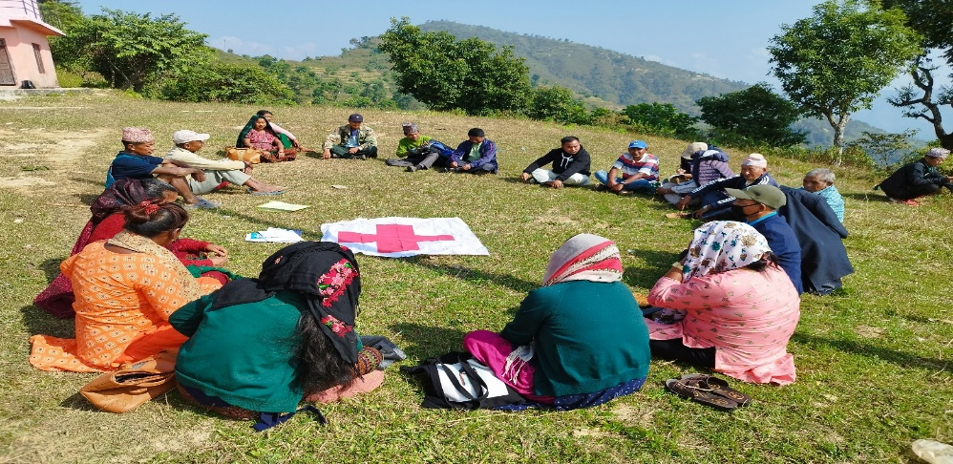
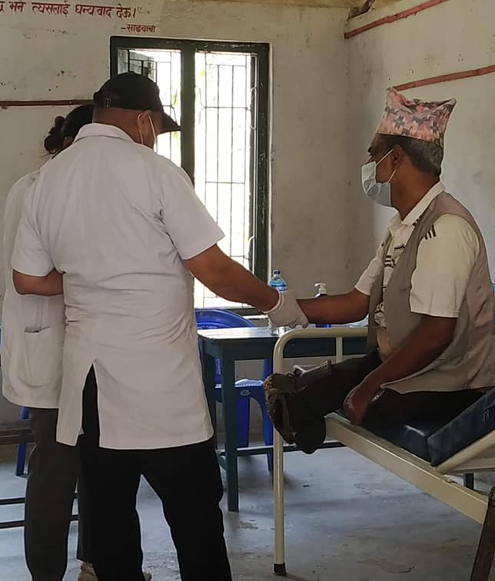
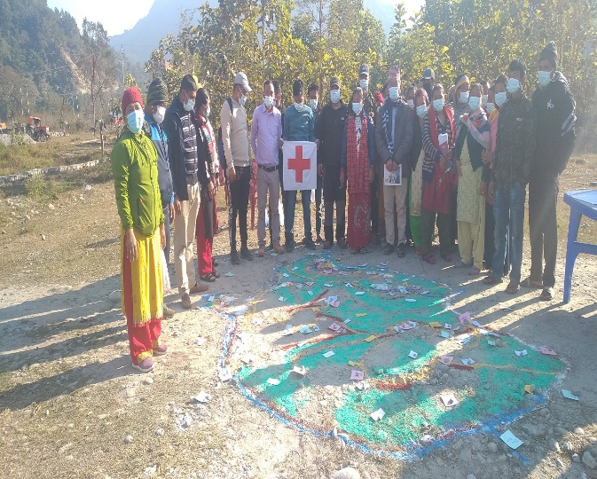
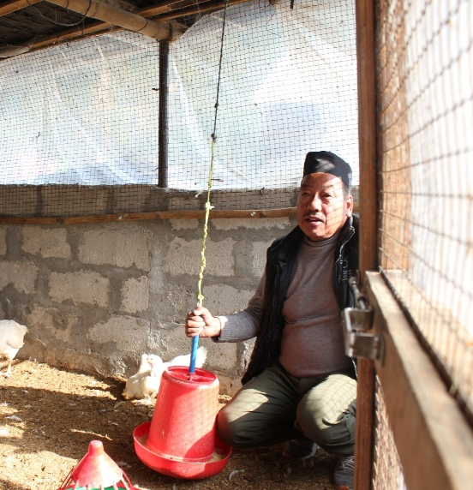
Empowering and capacity building
Health care
Livelihood Support
Disability Inclusive
Disaster Risk Reduction

